Slide 1
How to add your own text and photo
DC Campaign template

Slide 2

Change text
All text are editable, just click on the text field

Slide 3
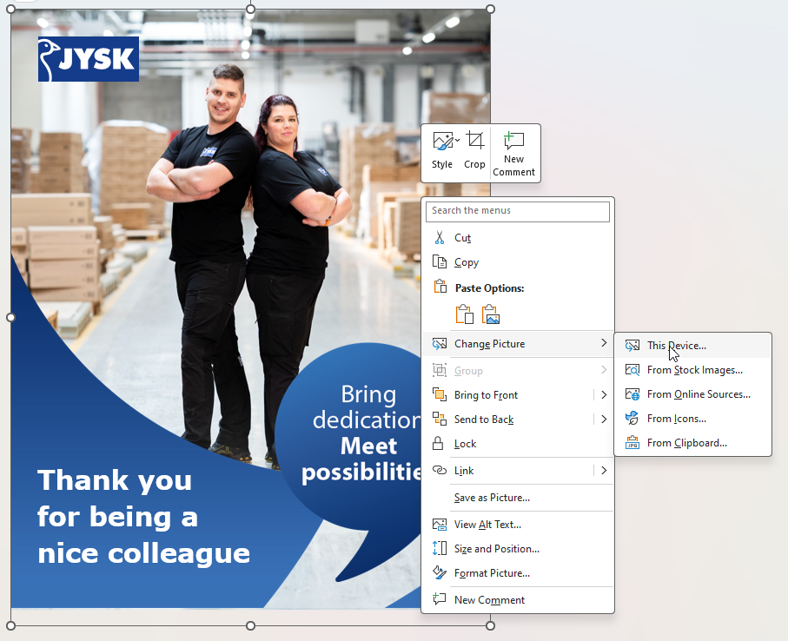
How to change photo
Right click on the current photo
  Select “Change picture”
  Select “This Device”
  Choose your own photo

Slide 4
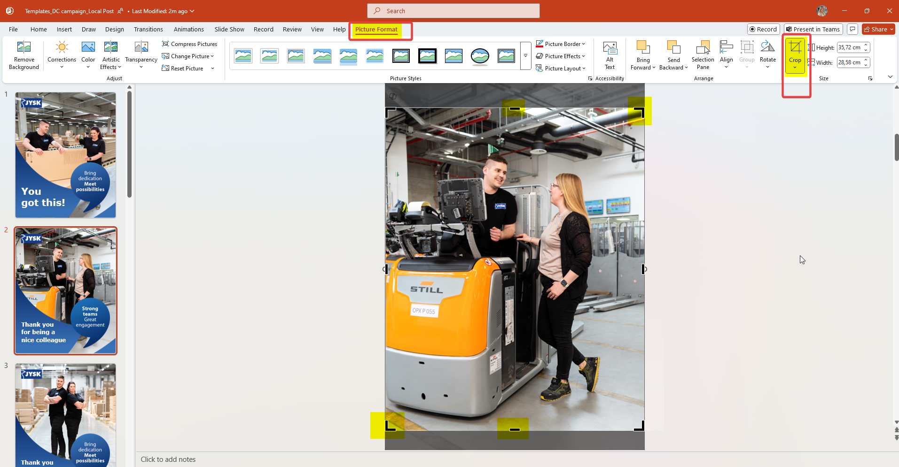
How to change photo
Click on “picture format”
Click on “crop”
Now you can adjust the photo in the frame
When you are happy with the crop, click anywhere outside of the photo

Slide 5

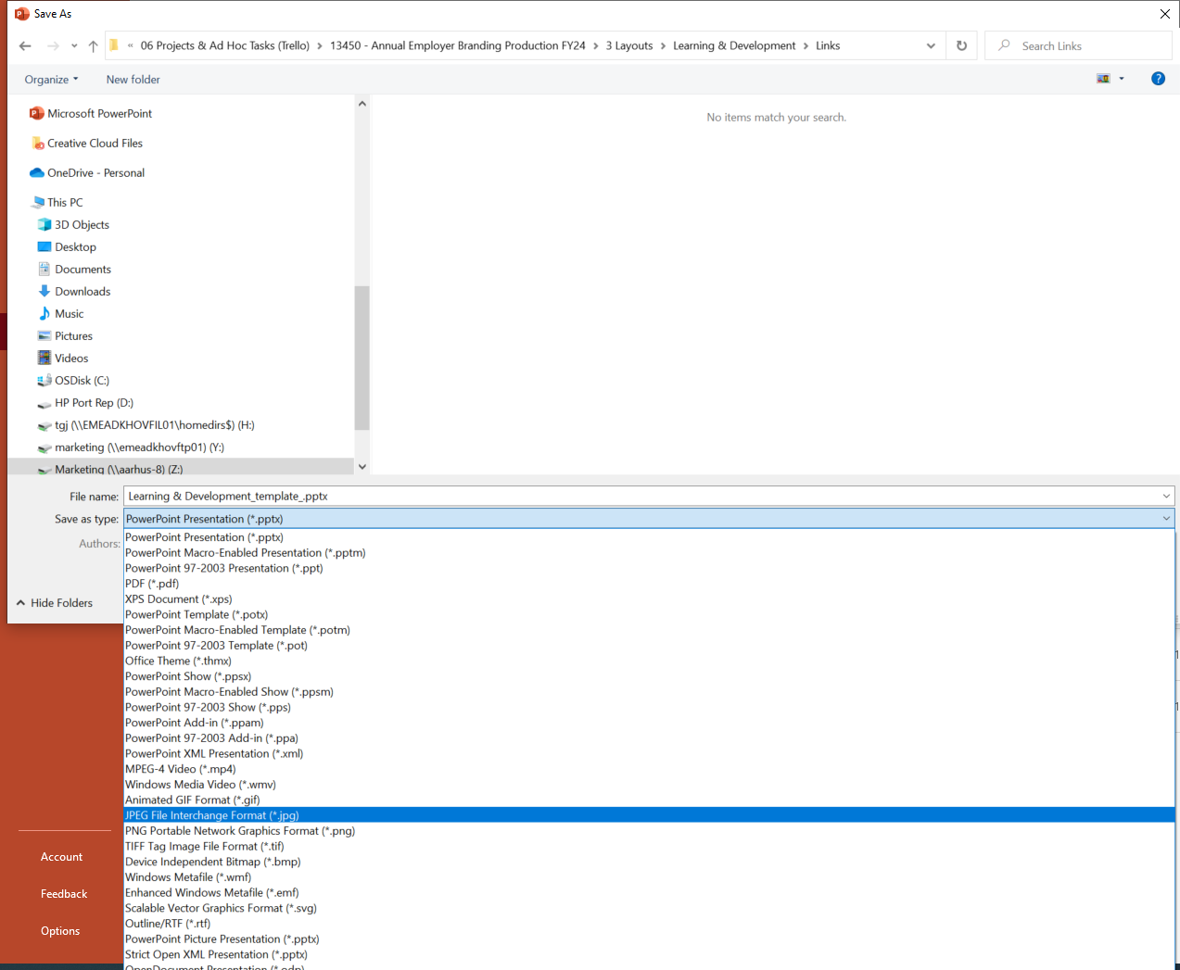
How to change photo
Now the template is ready.
Then save it as a JPEG to use it on social media
(e.g. Instagram, Facebook, LinkedIn).

