Slide 1
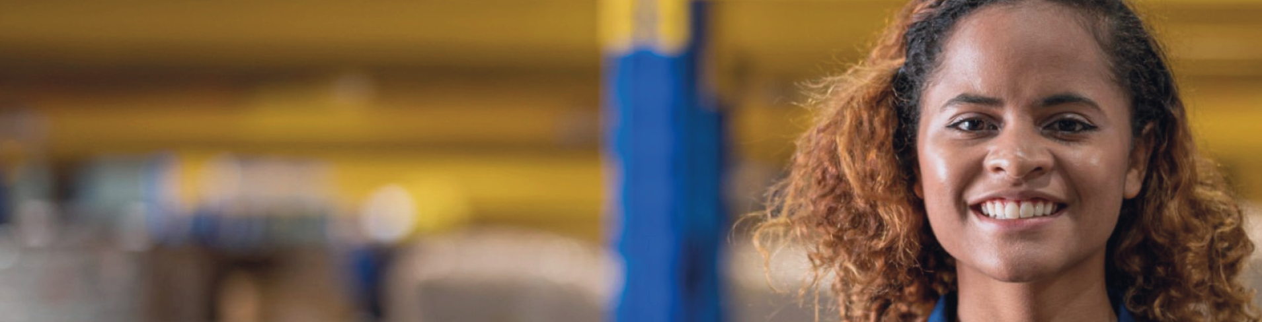



Dear Camilla
We’re proud that you choose to be JYSK
Camilla Meyer, Store Manager Viby
#ProudToBeJYSK
#ProudToBeJYSK

Slide 2
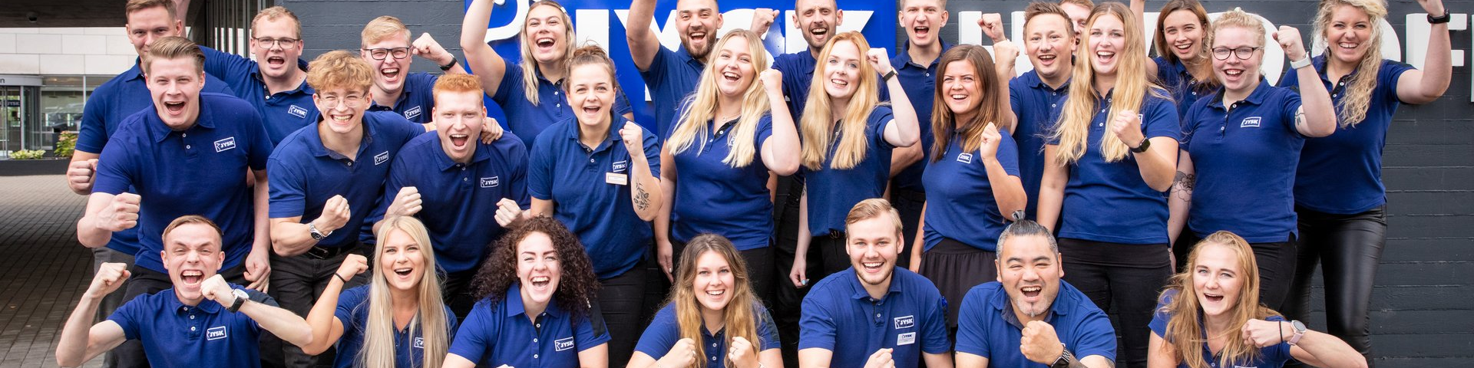
Dear Store Manager Trainees
We’re proud that you choose to be JYSK
#ProudToBeJYSK
Store manager Trainees, Denmark
#ProudToBeJYSK

Slide 3
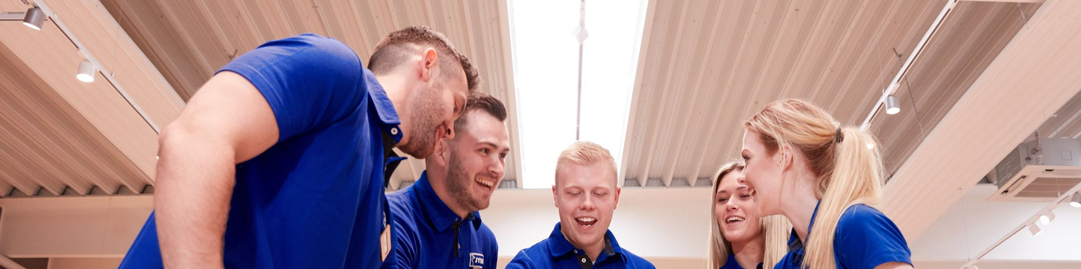
Dear Team Viby
We’re proud that you choose to be JYSK
Store team Viby
#ProudToBeJYSK
#ProudToBeJYSK

