Slide 1

VALUES

Slide 2




Tradesman
Colleague
Built on
Values
Corporate spirit

Slide 3





Corporate Spirit
Tradesman
Colleague
Built on Values

Slide 4

Built on
Values

Slide 5




Tradesman
Service-minded
Cost-conscious
Reliable
Goal-oriented

Slide 6


Colleague
Helpful
Mutual respect
Flexible
Open, honest and straightforward
Positive

Slide 7


Corporate Spirit
Committed
Loyal
Cooperative
The duty to speak up
JYSK ambassador

Slide 8

Name
[Position]
At JYSK [store XX/HO/DC]
“I work professionally and service oriented.”
Tradesman

Slide 9
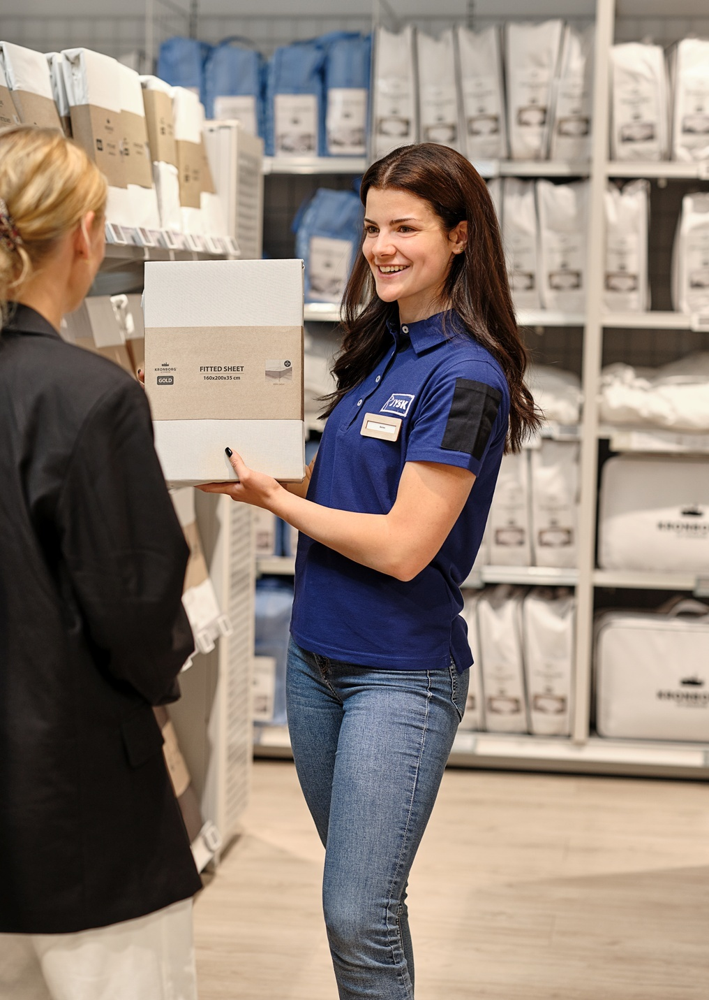


Tradesman
2020
Retail Manger
2004
District Manager
2001
Store Manager
1999
Ausbildung
NAME XX
“I work professionally and service oriented.”

Slide 10
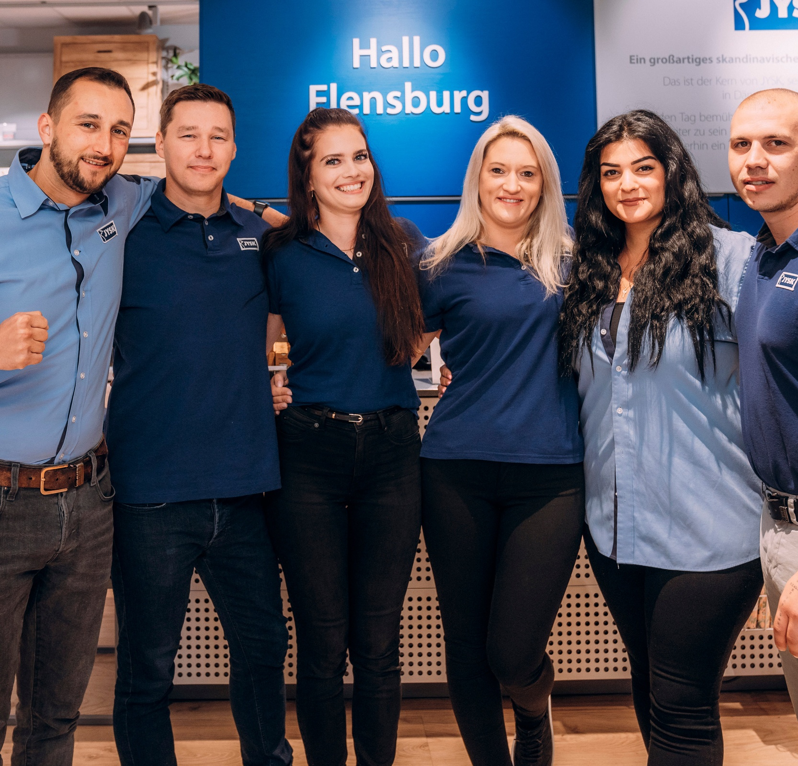
“Mutual respect makes our team strong!”
Colleague

Slide 11
LEADERSHIP

Slide 12


Leader
Coach
Built on
Leadership
Communicator

Slide 13




Leader
Communicator
Coach
Built on Leadership

Slide 14



Built on
Leadership

Slide 15
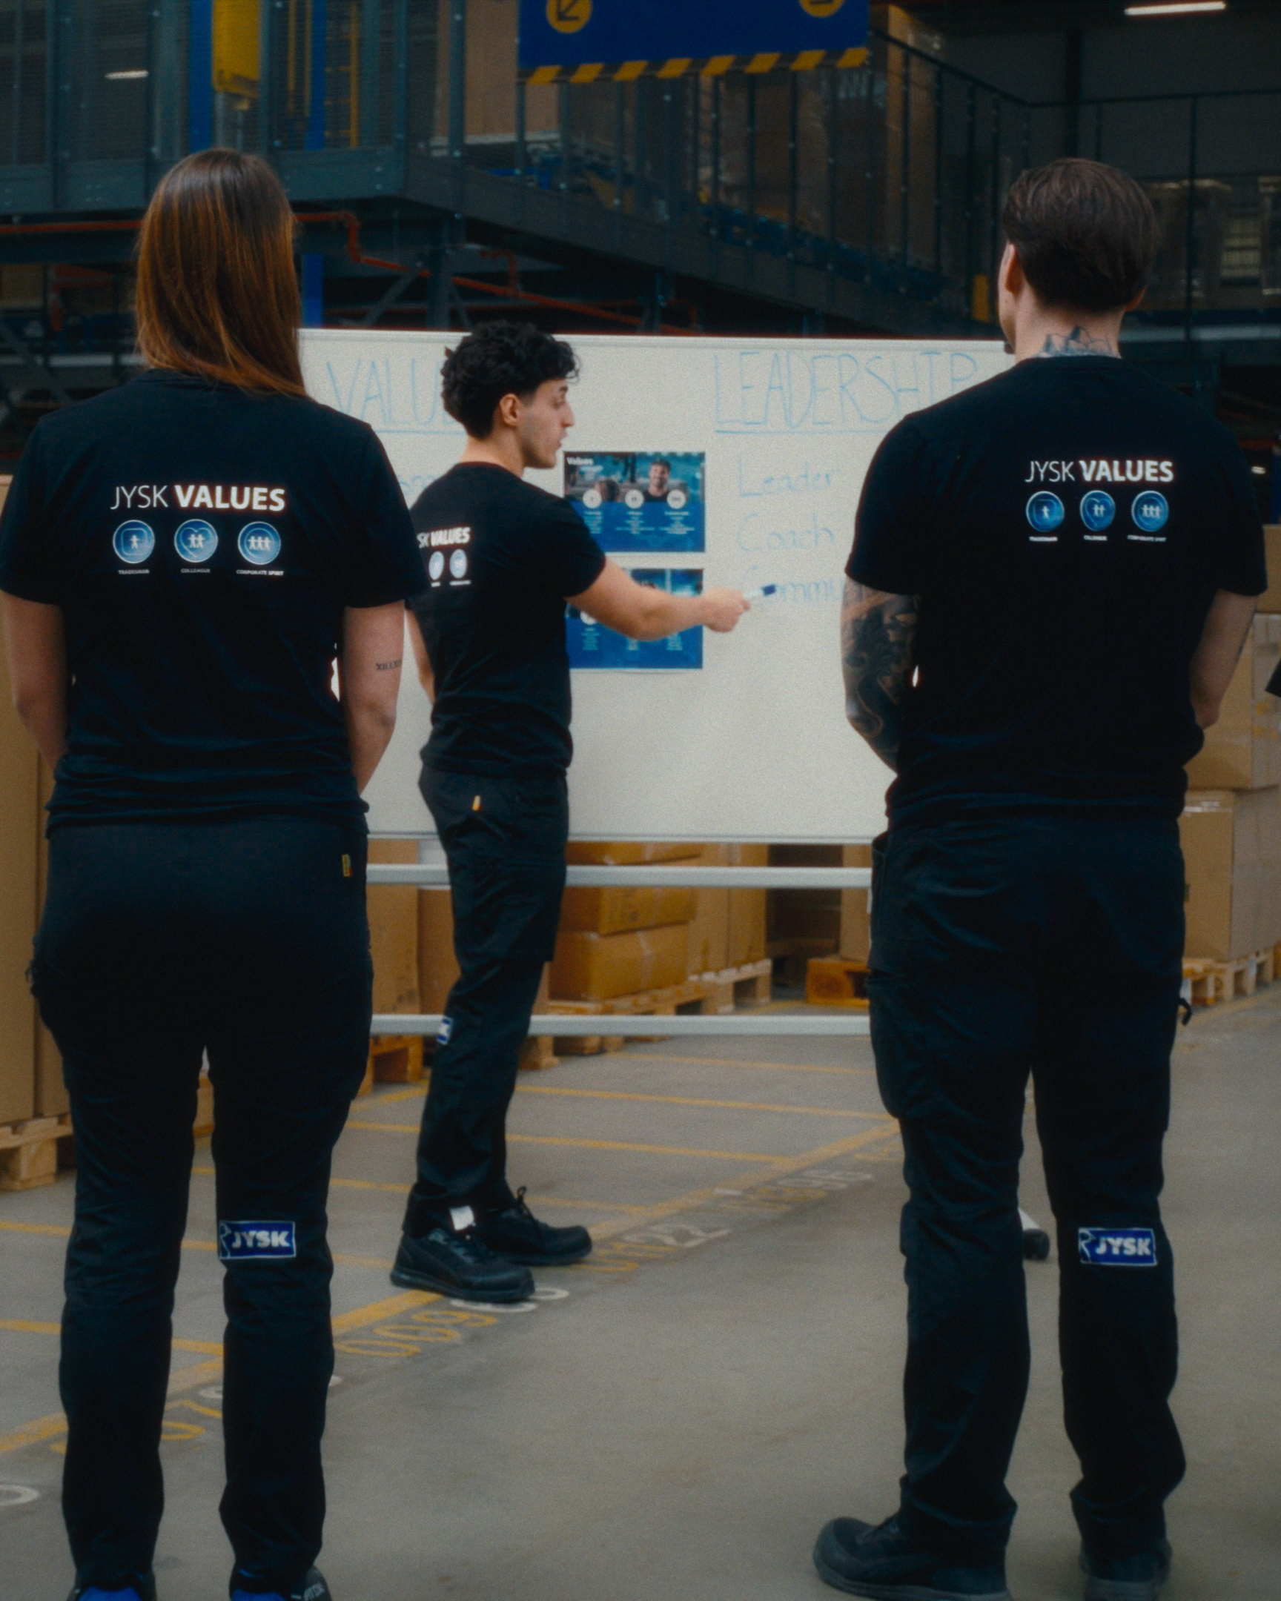

Leader
Result-oriented
Decisive
Responsible
Proactive
Empowering

Slide 16
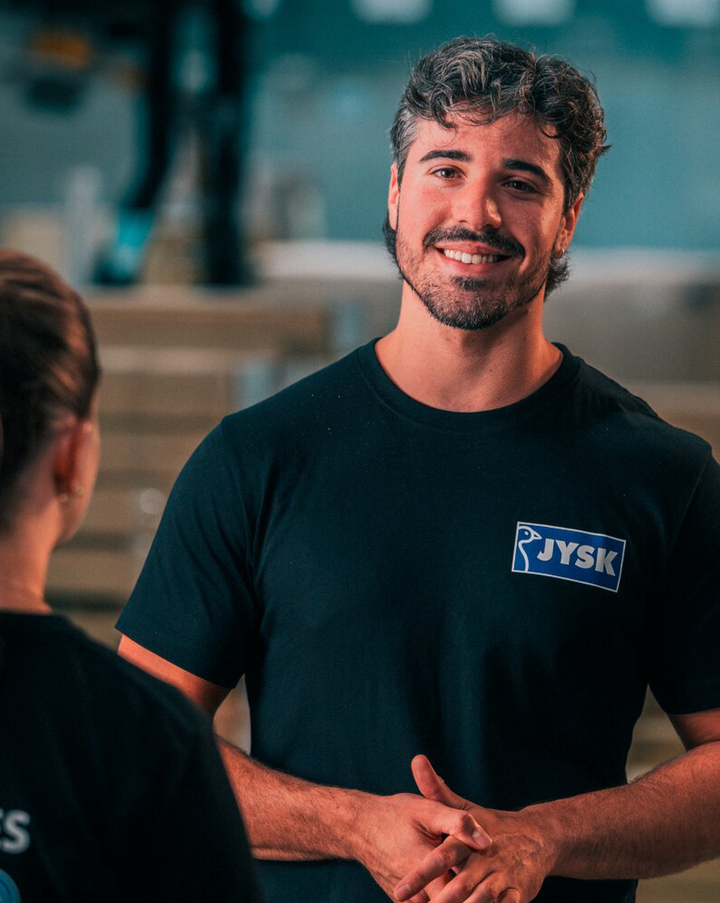

Coach
Developing
Involving
Feedback
Focusing
Follow up

Slide 17

Communicator
Visible
Motivating
Convincing
Informative
Keep it simple

Slide 18

Name
[Position]
At JYSK [store XX/HO/DC]
“As a Leader, I’m proactive and result-oriented.”

Slide 19
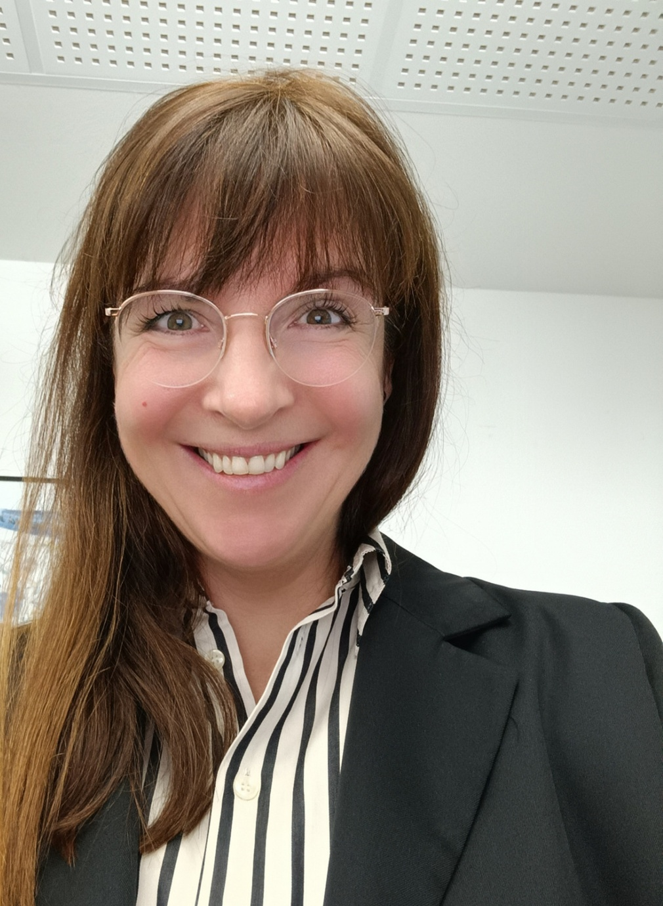
Leader
2020
Retail Manager
2004
District Manager
2001
Store Manager
1999
Apprentice
NAME XX
“As a Leader, I’m proactive and result-oriented.”

Slide 20
GUIDE
How to customise the template

Slide 21

Change text
All text are editable, just click on the text field

Slide 22
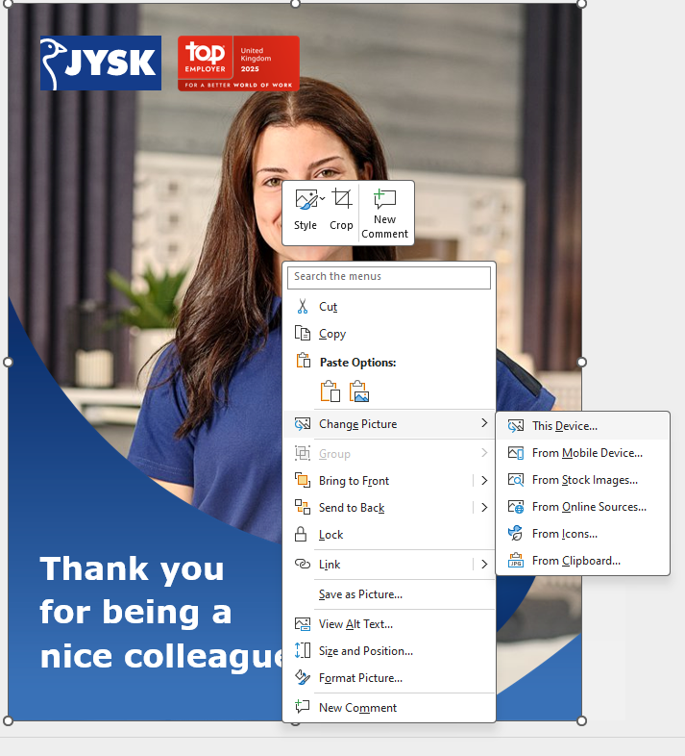
How to change photo
Right click on the current photo
Select “Change picture”
Select “This Device”
Choose your own photo

Slide 23
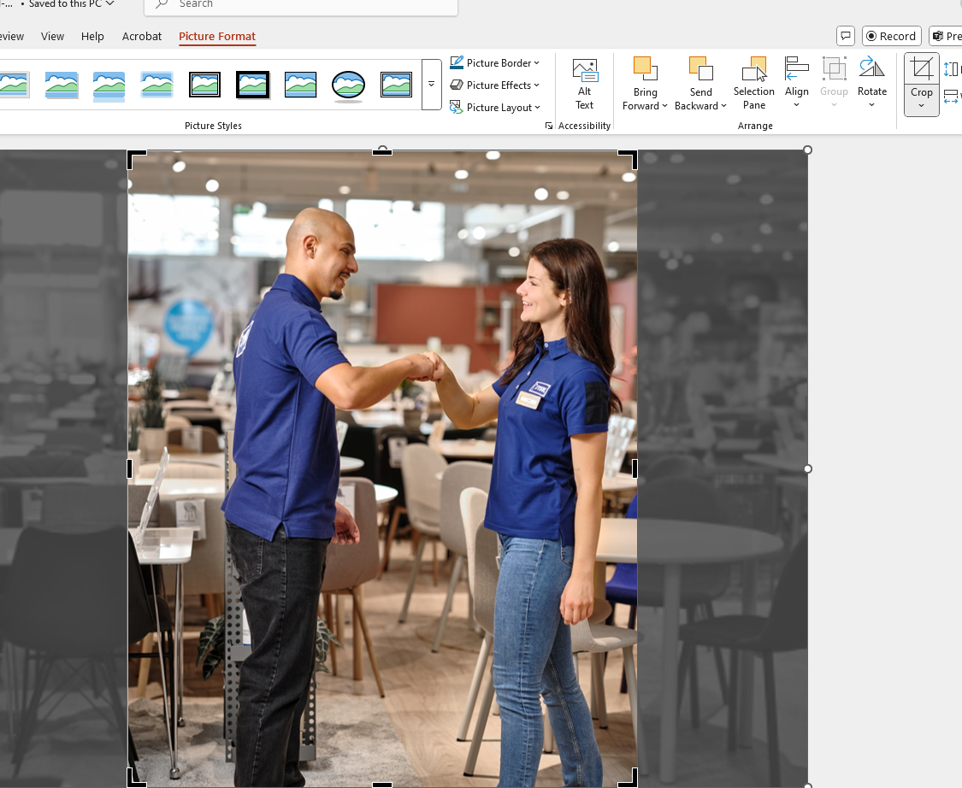
How to change photo
Click on “picture format”
Click on “crop”
Now you can adjust the photo
In the frame
When you are happy with the crop,
Click anywhere outside of the photo

Slide 24
GUIDE
How to customise the template

Slide 25
Change text
All text are editable, just click on the text field

Slide 26
How to change photo
Right click on the current photo
Select “Change picture”
Select “This Device”
Choose your own photo

Slide 27
How to change photo
Click on “picture format”
Click on “crop”
Now you can adjust the photo
In the frame
When you are happy with the crop,
Click anywhere outside of the photo

Slide 28

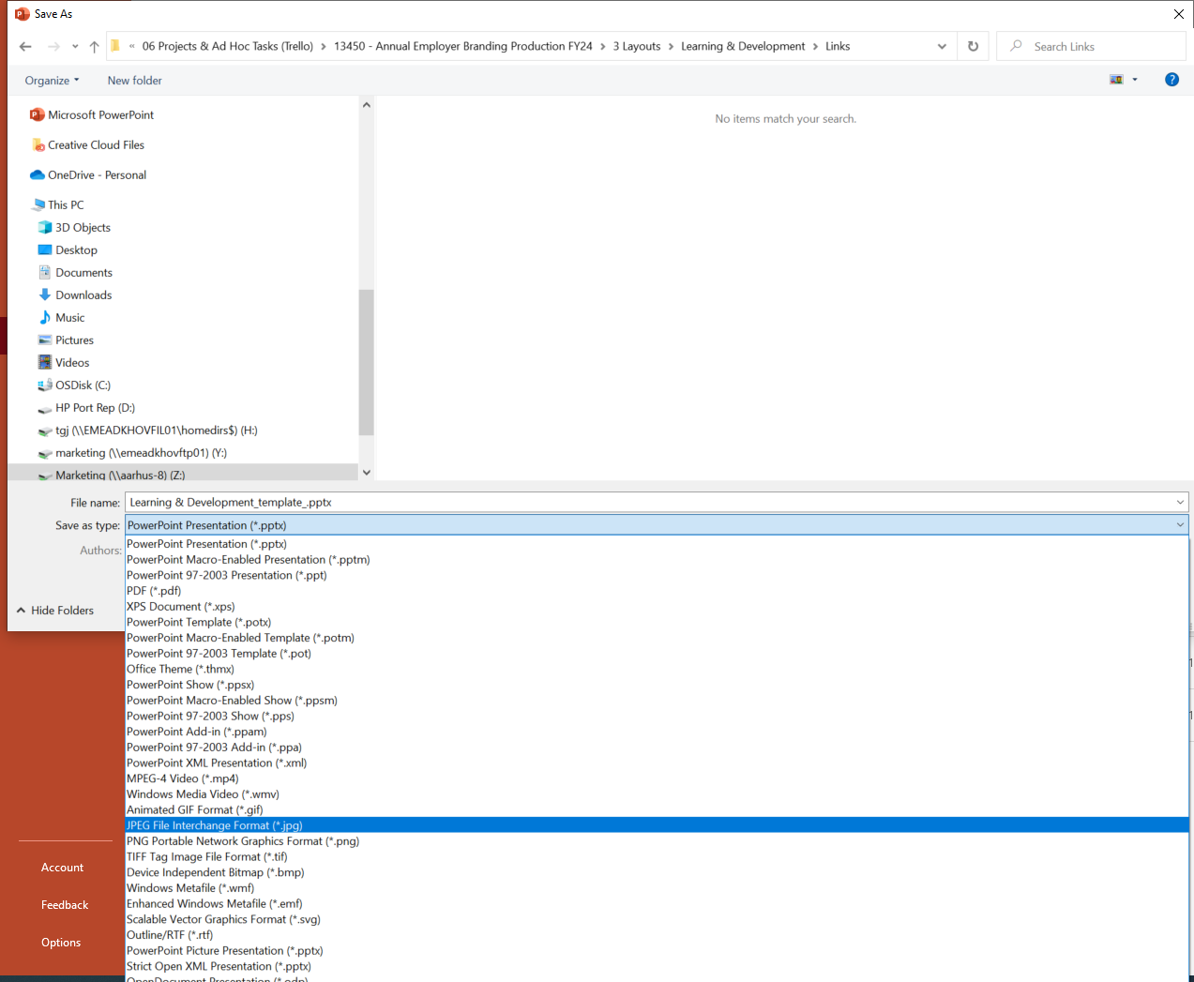
How to change photo
Now the template is ready.
Then save it as a JPEG
to use it on SoMe.

Slide 29
If you need help, please contact your local HR.

