Slide 1
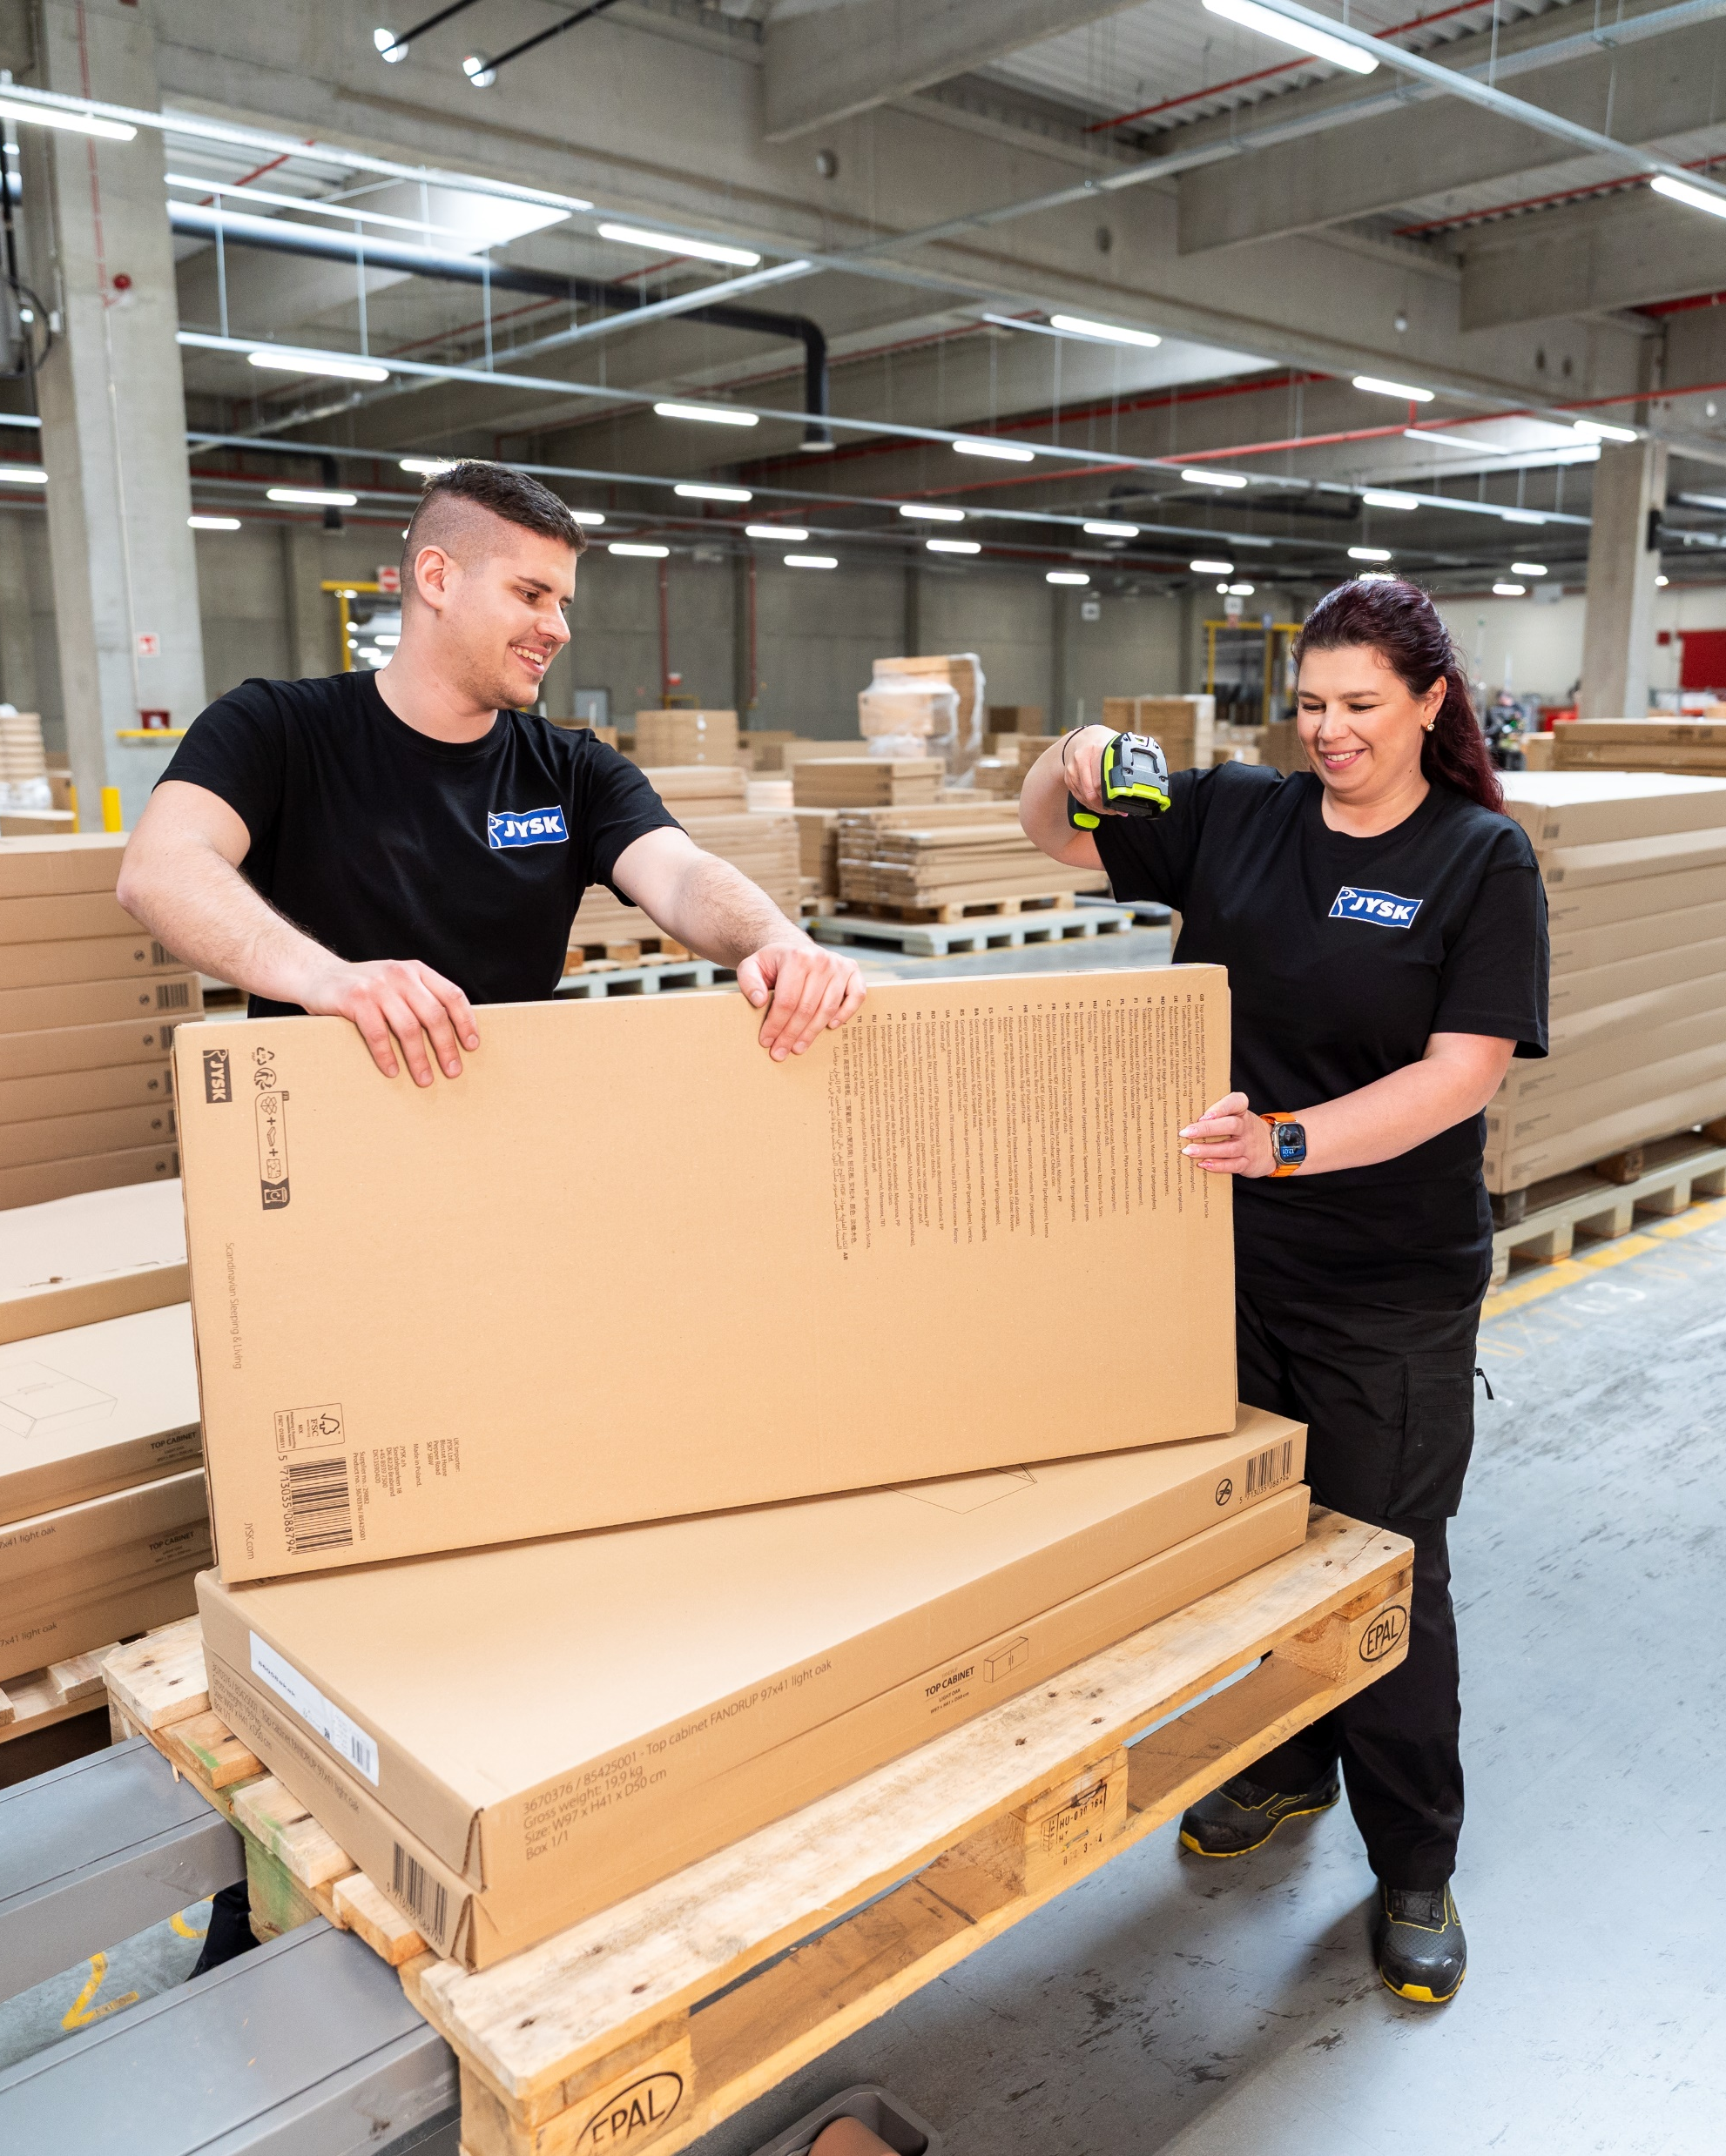


You
got this!

Slide 2
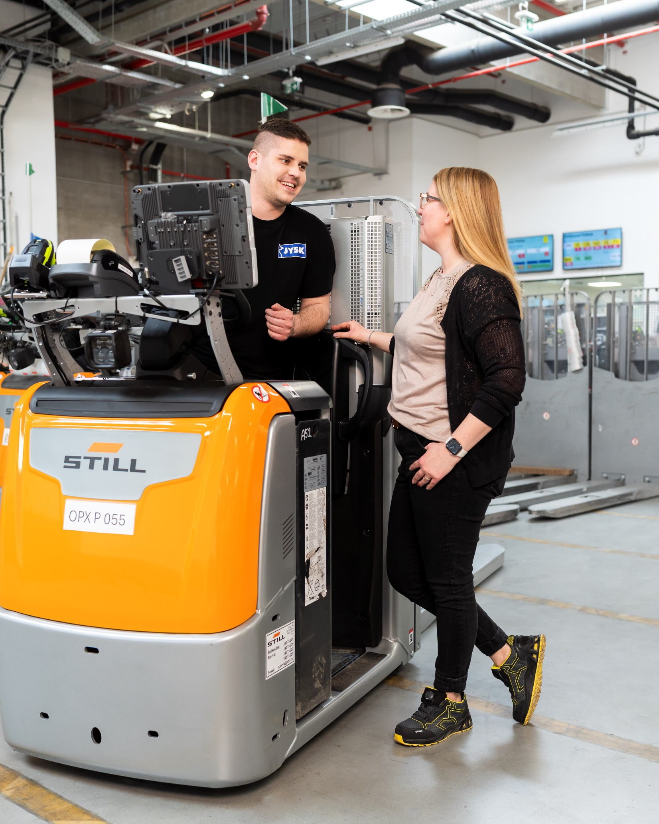

Thank you
for being a
nice colleague

Slide 3

Thank you
for being a
nice colleague

Slide 4
Thank you
for being a
nice colleague

Slide 5



1999
Apprentice
2001
Warehouse worker
2004
Area Responsible
2020
Team Leader
ONLY MY
ATTITUDE COUNTS

Slide 6




1999
Temp worker
2001
Warehouse
employee
2004
Area Responsible
Renata
2025
Team Leader
“WITH THE RIGHT DEDICATION
I CAN ACHIEVE EVERYTHING.”

Slide 7
1999
Apprentice
2001
Warehouse worker
2004
Area Responsible
2020
Team Leader
ONLY MY
ATTITUDE COUNTS

Slide 8
1999
Temp worker
2001
Warehouse employee
2004
Area Responsible
Renata
2025
Team Leader
“WITH THE RIGHT DEDICATION
I CAN ACHIEVE EVERYTHING.”

Slide 9
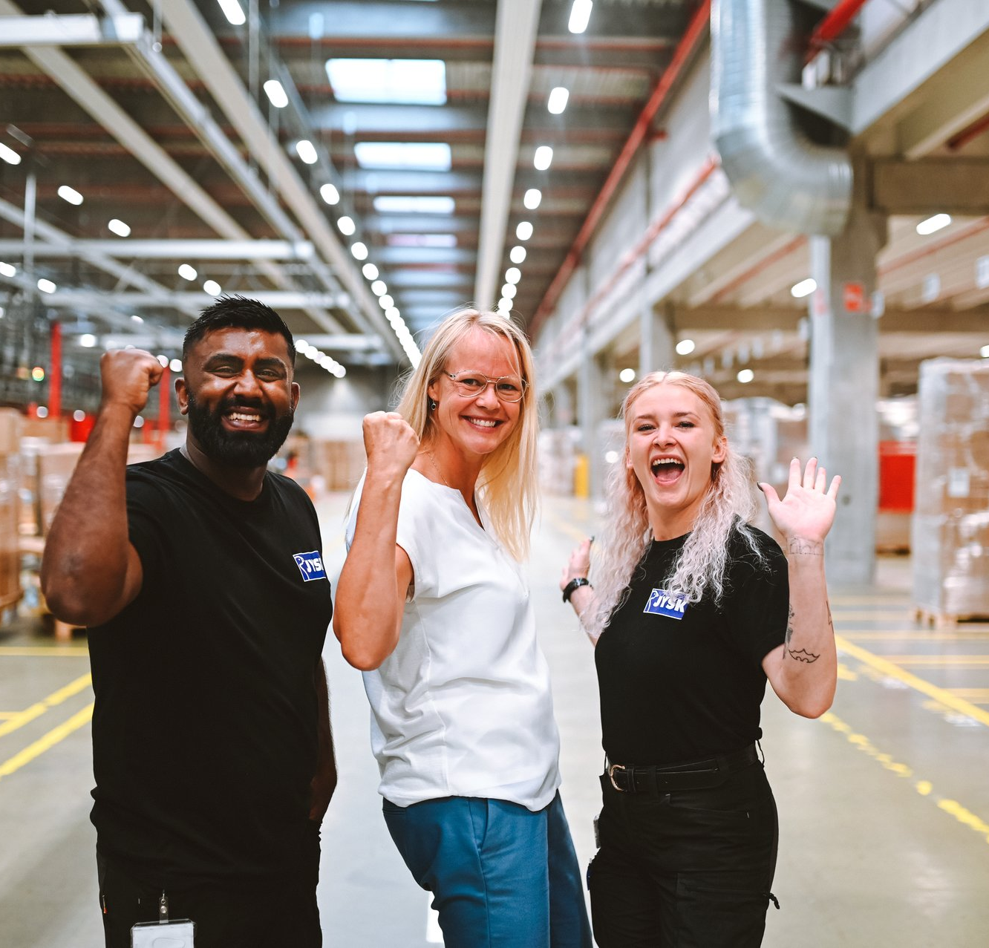

“WE ARE ONLY SUCCESSFUL AS A TEAM”

Slide 10

“WE ARE ONLY SUCCESSFUL AS A TEAM.”

