Slide 1




You
got this!

Slide 2

Thank you
for being a
nice colleague

Slide 3

Thank you
for being a
nice colleague

Slide 4
Thank you
for being a
nice colleague

Slide 5
Template suggestions
from JDE

Slide 6

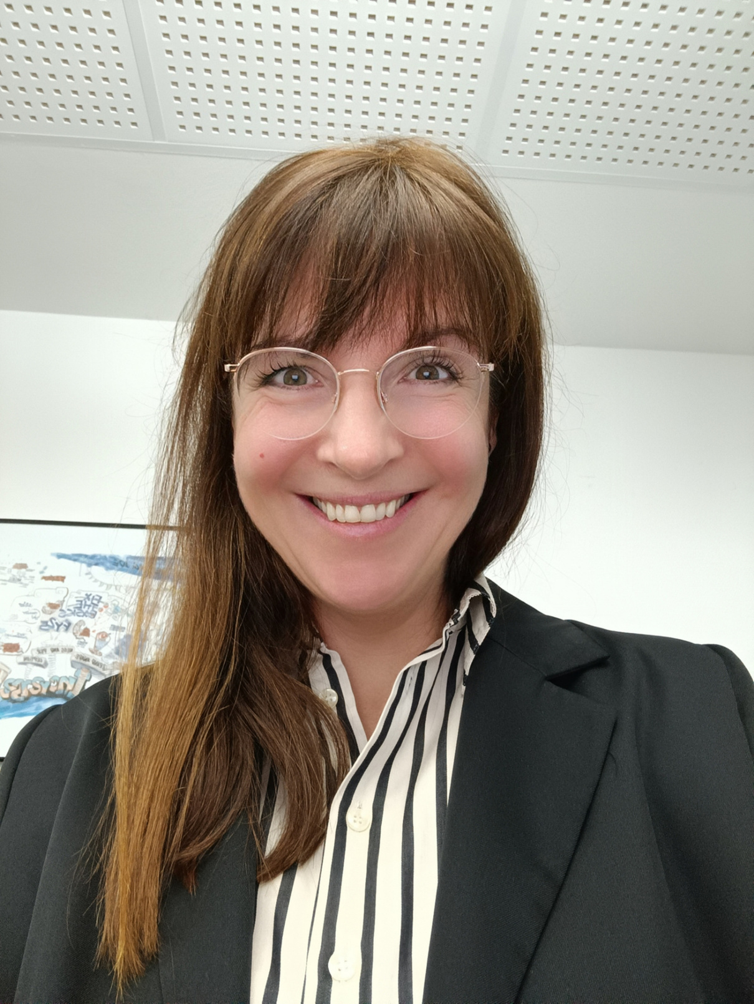


1999
Apprentice
2001
Store Manager
2004
District Manager
2020
Employer
Branding Lead
ONLY MY
ATTITUDE COUNTS

Slide 7



1999
Apprentice
2001
Store Manager
2004
District Managerin
Marica
2020
Employer Branding Lead
“WITH THE RIGHT DEDICATION
I CAN ACHIEVE EVERYTHING.”

Slide 8

1999
Apprentice
2001
Store Manager
2004
District Manager
Marica
2020
Employer Branding Lead
“WITH THE RIGHT DEDICATION
I CAN ACHIEVE EVERYTHING.”

Slide 9

1999
Apprentice
2001
Store Manager
2004
District Manager
Marica
2020
Employer Branding Lead
“WITH THE RIGHT DEDICATION
I CAN ACHIEVE EVERYTHING.”

Slide 10
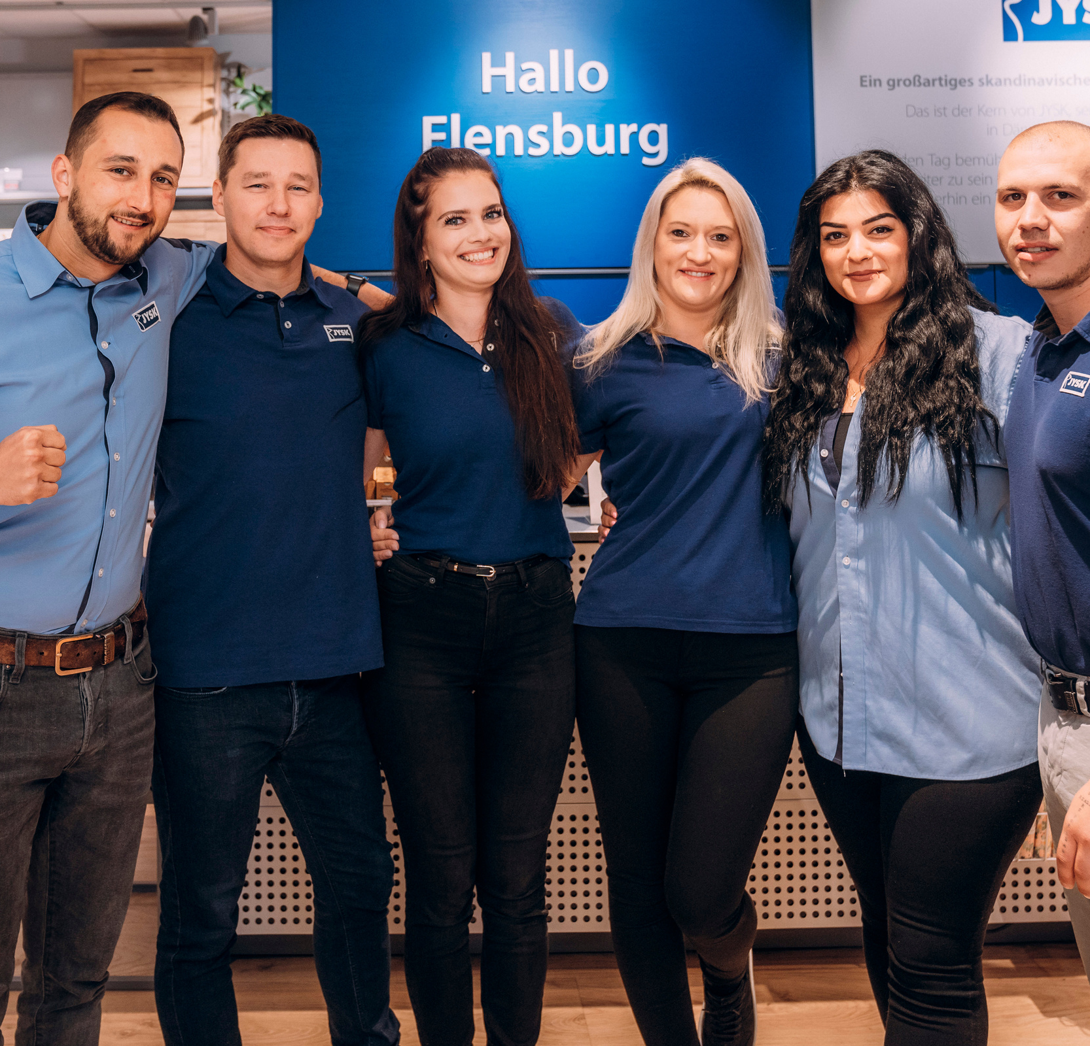

“WE ARE ONLY SUCCESSFUL AS A TEAM”

Slide 11
“WE ARE ONLY SUCCESSFUL AS A TEAM.”

